Slide 1
Birth of comparative and historical linguistics

Slide 2
Birth of comparative-historical linguistics
William Jones and other forerunners of historical linguistics.
Franz Bopp, Rasmus Rask, Jacob Grimm and Alexander Vostokov as founders of comparative-historical linguistics.
Wilhelm von Humboldt’s linguistic heritage.

Slide 3
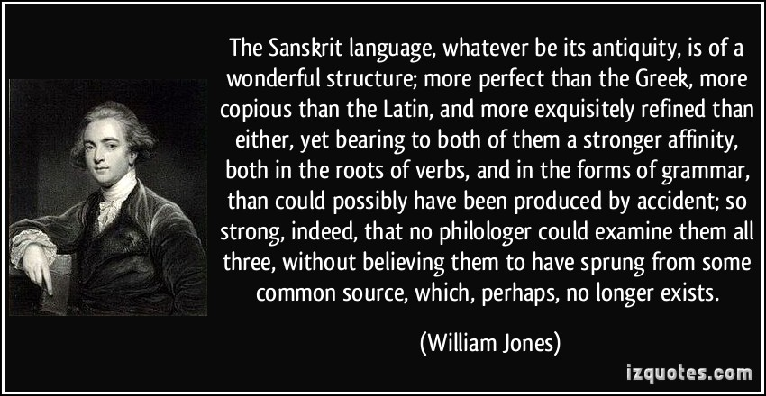
William Jones and other forerunners of historical linguistics
1786 Sir William Jones In his Third Anniversary Discourse to the Asiatic Society in Calcutta suggested that Sanskrit, Greek and Latin languages had a common root, and that indeed they may all be further related, in turn, to Gothic and the Celtic languages, as well as to Persian.

Slide 4
William Jones and other forerunners of historical linguistics .
From Dante onward, through and after the Renaissance, various disconnected attempts had been made at historically oriented comparisons between languages, though the focus of linguistic research had been on synchronic studies, description and analysis of languages.

Slide 5
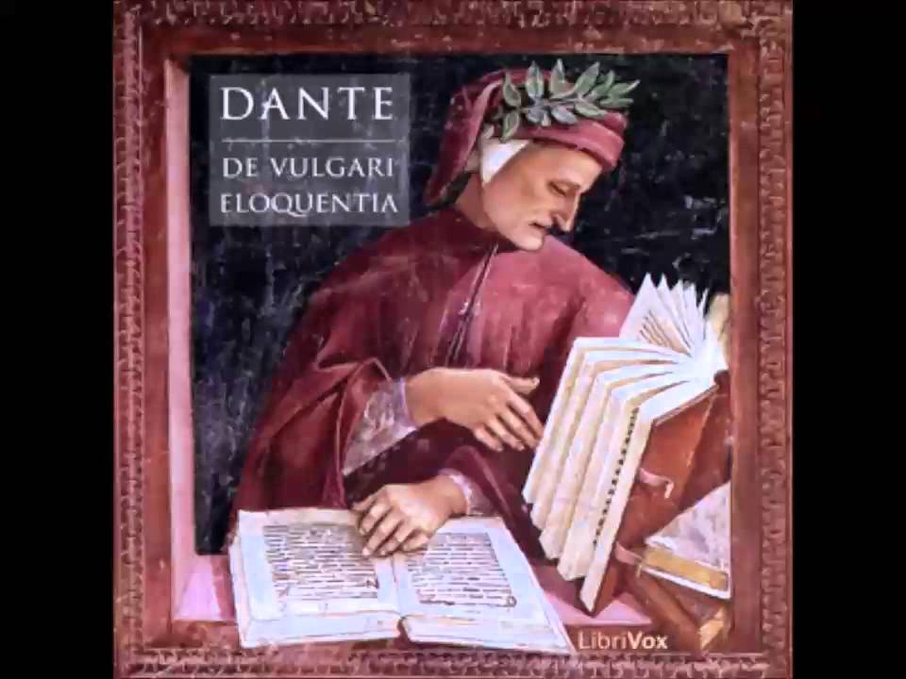
William Jones and other forerunners of historical linguistics .
Dante “De vulgari eloquentia”
The language was born unitary as a gift from God to Adam (Hebrew) and, at a later stage, was separated into different idioms because of the arrogance demonstrated by humankind
at the time of the building of the Tower of Babel.
Three properly European language families :
Germanic
Latin
Greek

Slide 6
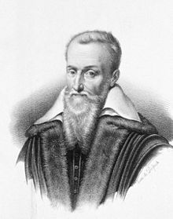
William Jones and other forerunners of historical linguistics .
Joseph Scaliger (1540-1609)
dispensed with two false dogmas:
that Latin descended from Greek
that all languages descended from Hebrew
Recognized 11 language families in Europe, four major and seven minor.
Major language families correspond to the present-day
Romance (Deus languages)
Greek (Theos languages)
Germanic (Godt languages)
Slavic (Boge languages)

Slide 7
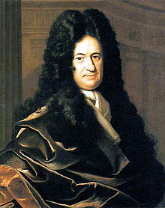
William Jones and other forerunners of historical linguistics .
Leibniz(1646-1716)
supported monogenetic theory of world’s languages
placed Hebrew within the Arabic language family
was one of the first to notice historical relationship between Finnish and Hungarian
set up two major divisions of the original language, Japhetic or Kelto-Scythian (northern or European languages) and Aramaic (languages of the South)
encouraged rulers of Russia to begin surveying many non-European languages on their territory

Slide 8
William Jones and other forerunners of historical linguistics .
18th century
Many linguists tried to answer the question:
What lay between the beginnings of human language and its present form?

Slide 9
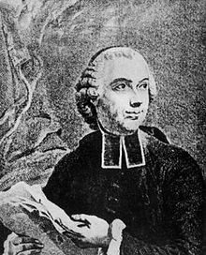
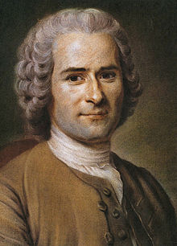
William Jones and other forerunners of historical linguistics .
18th century
French philosophers de Condillac and Rousseau discussed the origin and early development of human speech.
Genesis of the language:
Language originated in deictic and imitative gestures and natural cries > the phonic element became dominant as specific sound sequences were semantically associated with phenomena and the power of human thought increased.
Abstract vocabulary and grammatical complexity developed from an earlier individual concrete vocabulary with few grammatical distinctions or constraints.

Slide 10
William Jones and other forerunners of historical linguistics .
18th century
Johann Peter Süßmilch “The Divine order in the circumstances of the human sex, birth, death and reproduction”:
The complexity and perfect ordering of languages could only be explained as the direct gift of God to mankind.
1769
Prussian Academy offered a prize for an essay answering
the questions:
Could man have evolved, unaided, the language as it is known?
If yes, how could man go about it?

Slide 11
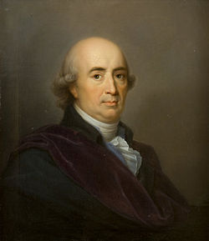
William Jones and other forerunners of historical linguistics .
Johann Gottfried Herder
(winner of the prize)
“Treatise on the Origin of Language” (1772)
Thought is essentially dependent on, and bounded in scope by, language — i.e. one can only think if one has a language, and one can only think what one can express linguistically.
Meanings or concepts are to be equated with usages of words.
Conceptualization results from sensation. We are able to achieve non-empirical concepts by means of a sort of metaphorical extension from the empirical ones.

Slide 12
William Jones and other forerunners of historical linguistics .
Johann Gottfried Herder on the origin of the language:
Language is not a gift from God.
Man has his five senses, and he is gifted with reason; nevertheless, with all his talents he would be forlorn in the world without his specific human language. Creation of language and culture by means of his natural talents is distinctive of man’s nature.
Sound, a product of the human tongue, and conception, a product of the human reason, must be adjusted to each other.

Slide 13
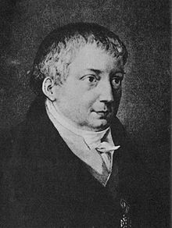
William Jones and other forerunners of historical linguistics
Friedrich Schlegel
„Über die Sprache und Weisheit der Indier“ (1808)
stressed the importance of studying the “inner structures” of languages (i.e. their morphology) for the better understanding of their genetic relationship
was the first to use the term “comparative grammar”
compared Sanskrit with Latin, Greek, Persian and German and found similarities in vocabulary and grammar

Slide 14
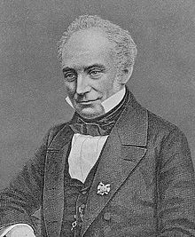
Franz Bopp, Rasmus Rask, Jacob Grimm and Alexander Vostokov as founders of comparative-historical linguistics
Franz Bopp(1791-1867), German linguist
“Über das Conjugationssystem der Sanskritsprache in Vergleichung mit jenem der griechischen, lateinischen, persischen und germanischen Sprache“ (1816)
traced the common origin of those languages' grammatical forms, of their inflections
planned to reconstruct the original grammatical structure of the language whose gradual disintegration produced languages of the Indo-European family

Slide 15
Franz Bopp, Rasmus Rask, Jacob Grimm and Alexander Vostokov as founders of comparative-historical linguistics
In his quest for the original state of the Indo-European language Bopp was led to discover the principles of comparative grammar as Christopher Columbus discovered America in his search for a new route to India
Antoine Meillet,
one of the most important French linguists of the early 20th century

Slide 16
Franz Bopp, Rasmus Rask, Jacob Grimm and Alexander Vostokov as founders of comparative-historical linguistics
Franz Bopp(1791-1867), German linguist
“Ausführliches Lehrgebäude der Sanskritsprache “ (1827)
„Vergleichende Grammatik des Sanskrit, Zend, Griechischen, Lateinischen, Litthauischen, Altslawischen, Gotischen und Deutschen“
(1833-1852)
Aims:
comparative description of the languages concerned
investigation of the laws governing them
discovery of the origin of their inflectional forms

Slide 17
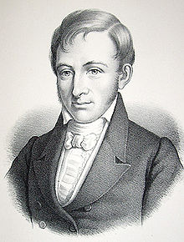
Franz Bopp, Rasmus Rask, Jacob Grimm and Alexander Vostokov as founders of comparative-historical linguistics
Rasmus Rask (1787-1832)
Danish linguist
author of the first systematic grammars of Old Norse and Old English
brought order into etymological relationships by setting out systematic comparisons of word forms, matching a sound in one language with a sound in another exemplified in numbers of different words
discovered correspondences known as Germanic Sound Shift
“If there is found between two languages agreement in the forms of indispensible words to such an extent that rules of letter changes can be discovered for passing from one to the other, then there is a basic relationship between these languages”

Slide 18
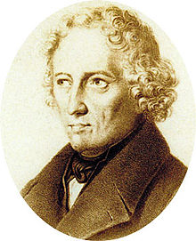
Franz Bopp, Rasmus Rask, Jacob Grimm and Alexander Vostokov as founders of comparative-historical linguistics
Jacob Grimm(1785-1863)
German philologist, author of Deutsche Grammatik (1822)
formulated the first of the sound laws that were to form the structure and support of Indo-European and other language families
“The sound shift is a general tendency; it is not followed in every case”
believed that philology must be based on strict adherence to the laws of sound change to be scientific

Slide 19
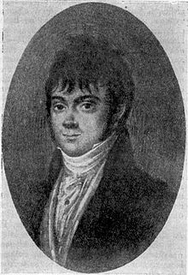
Franz Bopp, Rasmus Rask, Jacob Grimm and Alexander Vostokov as founders of comparative-historical linguistics
Alexander Vostokov (1781-1864)
Russian philologist, author of «Рассуждение о славянском языке, служащее введением к Грамматике сего языка, составляемой по древнейшим оного письменным памятникам» (1820)
the first work on historical phonetics of the Slavonic languages as a group of Indo-European languages

Slide 20
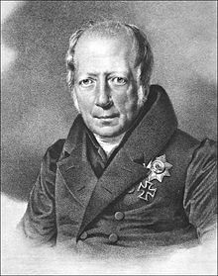
Wilhelm von Humboldt’s linguistic heritage
Wilhelm von Humboldt (1767-1835)
Prussian philosopher, government official, reformer of education, linguist
„Über die Verschiedenheit des menschlichen Sprachbaus und ihren Einfluss auf die geistige Entwicklung des Menschengeschlechts“

Slide 21
Wilhelm von Humboldt’s linguistic heritage
Humboldt’s theory of language lays stress on the creative linguistic ability inherent in every speaker’s mind:
language is not the product of speaking and writing, it is the living capability by which speakers produce and understand utterances.

Slide 22
Wilhelm von Humboldt’s linguistic heritage
Language is an essential part of the human mind
Languages can be changed and adapted as circumstances require
that explains the mystery of language:
Speakers can make infinite use of the finite linguistic resources available to them at any time
No matter how much you describe or analyze a language, something of its essential nature always remains unsaid

Slide 23
Wilhelm von Humboldt’s linguistic heritage
Though the capacity for language is universal, each language is a property of the nation or group who speak it.
The articulatory basis of speaking is common to all men, but sound serves only as the passive material for the structure of the language (innere Sprachform).
The separate Sprachform (semantic and grammatical structure) of each language constitutes its formal identity and difference from other languages.
Innere Sprachform of each language is responsible for the ordering and categorizing of the data of experience. >>>
>>>The speakers of different languages live partly in different worlds and have different systems of thinking.

Slide 24
Wilhelm von Humboldt’s linguistic heritage
Language and thought of a people are inseparable: “a people’s speech is their spirit, and their spirit is their speech”. Thinking and perception are only made definite and communicable through language.
Every language is the product of its past.
Differences between languages turn not merely on different speech sounds used by them, but involve differences in the speaker’s interpretation and understanding of the world they live in.

Slide 25
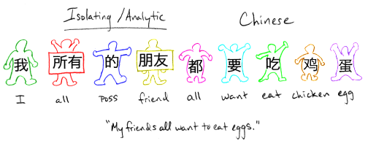
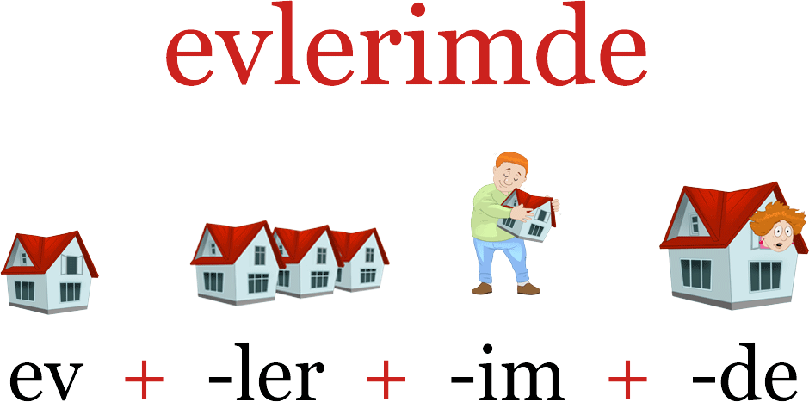
Wilhelm von Humboldt’s linguistic heritage
Humboldt’s tripartite typology of languages:
isolating
agglutinative
inflectional

Slide 26
Wilhelm von Humboldt’s linguistic heritage
Classification of sentence structure:
with no formal links between words (like Chinese)
where word forms signal grammatical relationship (like Sanskrit)
where essential structure of a sentence is incorporated into a single word, sentence-word (incorporating or polysynthetic languages, like American Indian languages)
tuntussuqatarniksaitengqiggtuq = "He had not yet said again that he was going to hunt reindeer.“ (Yupik language of Alaska)

