Slide 1
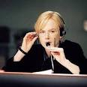
SEMANTIC ASPECTS OF INTERPRETATION

Slide 2
1. Semantic Structure of the Oral Message and its Main Components

Slide 3
Linguistics distinguishes between the notions of meaning, sense and semantics.

Slide 4
Meaning of linguistic units is usually described as their contents reflected in the respective dictionaries or grammar books.
The notion of sense goes outside pure linguistics and has to do, first of all, with 1) the context and 2) situation of communication (the subject field of communication, aims of participants, their background knowledge, etc.)

Slide 5
Therefore sense of linguistic units comes to life in real speech as a result of relations established between meanings of linguistic units and communicative situations.

Slide 6
Indeed, it is practically impossible to translate such words as:
challenge, benchmark, event, network, intervention, cohesion, рахунок, партія, фракція
until the word is placed in the context and until the act of predication (i.e. creation of a proposition) takes place.

Slide 7
Therefore, interpreters render the sense of linguistic units, which is generated in each particular act of speech as a result
of producing
messages by
the speakers.

Slide 8
Messages, both written and oral, have certain semantic structure, the main element of which is the proposition, in other words a "picture" of the world, a "statement" about the world, which may be true or false, which is (normally) pronounced with a certain purpose, and which (normally) has the subject and the predicate (elements of the predicative group)

Slide 9
Messages must contain the following components
Verbally expressed
(explicit)
“hidden”
implicit

Slide 10
The deictic component: orientation of the message with regard to the "person", "space" and "time":
e.g. I warn you that it is probably cold outside

Slide 11
The modal component:
treating the proposition of the speaker as possible, impossible, desired, mandatory, unnecessary, likely, doubtful etc.:
e.g. I warn you that it is probably cold outside

Slide 12
The evaluative component: positive or negative evaluation of the elements of the speaker's proposition (or "zero evaluation"):
I warn you that it is cold (negative evaluation) outside, so, since you are unwell (negative evaluation), you'd rather wear your warm (positive evaluation) sweater

Slide 13
The pragmatic component:
indicator of the aim of pronouncing the utterance (communicative intention)
as it is viewed by the speaker:
e.g. I warn (the act of warning) you that it is cold outside.

Slide 14
Conclusion:
It is quite obvious that for interpretation to be successful it is not enough to translate only the "propositional element" of the message but also to render all other components of its semantic structure, thus ensuring that it "makes sense" for the listener and produces desired effect upon him/her.

Slide 15
1.2. Semantic Redundancy.
Interpreter’s Note-Taking

Slide 16
Semantic redundancy (семантична надлишковість) is an important property of any speech, especially oral one.
It provides safeguards for successful transmission of information, i.e. ensures that the listener better understands the speaker and that the communicative intent of the speaker is achieved.

Slide 17
The phenomenon of semantic redundancy of speech makes it possible for interpreters to use the techniques of universal interpreter's note-taking (UINT) of oral messages in consecutive interpreting.
The main purpose of UINT is to create focuses of information for further subsequent "extraction" or "unpacking" the information by the interpreter.

Slide 18
Interpreters' alternative to standard stenography (shorthand), dates back to the Geneva University School of Interpreters set up under the auspices of the League of Nations in 1941.
Detailed description of interpreter's note-taking and practical recommendations on its application started to develop rapidly since
J-F. Rozan's epoch-making book on note-taking "La prise de notes, en interpretation consecutive" (Geneva, 1956).

Slide 19
In the former Soviet Union principles of note-taking were first suggested by R.K.Minyar-Beloruchev in his book on consecutive interpreting.
Principles and methods of interpreter's updated version of note-taking were further on developed by A.P. Chuzhakin, O.V. Rebriy.

Slide 20
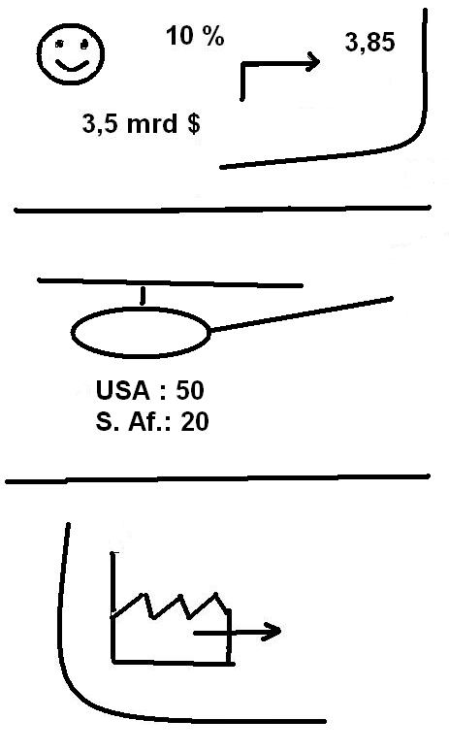

Slide 21
For example, the notes in the illustration might be interpreted to mean :
We are particularly glad to inform you about an important increase in our company’s revenues, which rose by 10 percent from 3.5 to 3.85 billion dollars.
This derives from huge sales of helicopters. The United States of America bought 50 and South Africa 20 of them.
On the other hand, we must relocate parts of our production in these countries.

Slide 22
Main principles of the interpreter's note-taking may be summarized as follows:
1. Each interpreter makes a choice according to his/her preference on how to apply IN;
2. IN creates safeguards for keeping in memory "precision" lexicon (dates, numerals, proper names, abbreviations, etc).

Slide 23
3. IN usually does not record separate words, but rather registers ideas, logical links, evaluation and modality.
4. Notes in IN are made in "a diagonal staircase" format either in the source or in the target languages, or

Slide 24
in a "mixed" way in the following sequence:
a) the subject group;
b) the verb-predicate group;
c) the object (direct and indirect) group;
d); e); f), etc. - adverbial modifiers and other parts of the utterance.

Slide 25
IN is based on a system of symbols and abbreviations, easy to remember, write down and decipher from the context.
This system may be briefly described as follows:
a) extensive use of commonly accepted abbreviations, acronyms and symbols, like: UN, UNESCO. WHO, WTO, NATO, OSCE, CEO

Slide 26
ПДВ,
ОВДП (Облігації внутрішньої державної позики),
ВІЛ, СНІД, M3C, MBC, СБУ,
BP (for Верховна Рада),
$, £, UAH, грн, etc;

Slide 27
occasional individual interpreter's shortenings, like: K (for Kyiv);
Kmin (for the Cabinet of Ministers);
bge for he did not go,
E (un­employment);
E for unemployment,
dr for draft, bdg for budget,
прзд for президент, сгдн for сьогодні, крв for керівник, etc;

Slide 28
c) logical and modal links are marked by symbols, like: : - to say;
OK- to approve, to support; OK - to condemn, to disapprove, to reject;
- today, at present;
> - more; < - less;
d (must, to be to, to have to, should) -obligation;
n (need) - necessity;
c (can), c? (could) - possibility;

Slide 29
d) the plural form is indicated by ² ; and the "very" by ³ ;
e) other commonly used symbols:
<- obtain, receive, attract;
-> -send, give, arrive;
<- E - export;
» - approximately;
! - danger, threat or emphasis on something

Slide 30
M - peace;
ДМ -democracy;
Ж -life;
П - party;
Eco - environment, ecology;
X - war;
P -policy, political;
(b+) - budget surplus

Slide 31
f) numerals are marked like:
t - thousand; m - million;
b - billion; tr -trillion;
g) dates are indicated as follows: 17.10.07 - 17 October 2007;
days of the week may be either commonly abbreviated: топ - Monday; tue - Tuesday, fri - Friday, sun - Sunday, or marked by a corresponding encircled number of the day

Slide 32
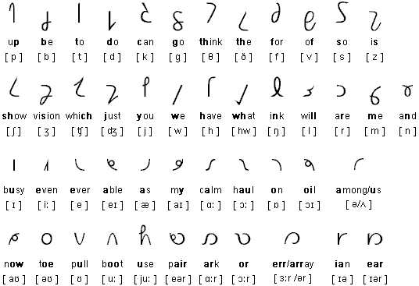
blocks of utterances which make up a complete thought and are to be interpreted are usually separated by horizontal lines, or encircled;

Slide 33
i) interpreters may use other combinations of arrows, lines, circles, parenthesis or abbreviations at their own discretion, provided there is a guarantee that they remember the "encoded" meaning of these symbols and do not overload their memory with the "third" meta-language of interpreter's note-taking.

Slide 34
Депутати Верховної Ради України відхилили у вівторок проект бюджету на 2007рік у другому читанні.

Slide 35
MP²BP
OK
dr bdg 07 (2 чит) tue

Slide 36
Note-taking skills is a powerful instrument capable to increase the volume of information rendered and to ensure higher precision of interpreting. This is especially important in consecutive interpreting when interpreters have to keep in memory long units of information and when taking notes is the only way of supporting interpreter's memory

